Slide 1

Transformer-Based Language Model with PyTorch
AI 417 – DL
Lab 9
Department of Artificial Intelligence
College of Computer and Cyber Sciences
Introduction to Deep Learning

Slide 2

1. Learning Objectives
Understand the fundamental concepts of Transformers
Understand the architecture and components of a Transformer-based language model.
Load and preprocess a real-world text dataset (WikiText-2) using Hugging Face.
Implement a Transformer encoder for next-word prediction using PyTorch.
Train the model on sequential word data.
Use the trained model to generate top predictions for next-word inference.

Slide 3
2. Explanation of Key Concepts
Hugging Face is a leading company and open-source platform in the field of ML. It provides tools, models, and libraries that make it easier for developers and researchers to build, deploy, and share machine learning applications.
Why is it Important?
Ease of Use: Hugging Face simplifies complex ML workflows, especially for those working with transformers.
State-of-the-Art Models: Hugging Face provides access to the latest breakthroughs in AI, helping users leverage cutting-edge models without needing extensive computational resources. It also give user access to lead multiple types of datasets.

Slide 4
2. Explanation of Key Concepts
What is WikiText-2 dataset?
A cleaned subset of Wikipedia, designed for training language models.
It keeps punctuation and case.
It’s often used in NLP for language modeling tasks.

Slide 5
Transformers

Slide 6
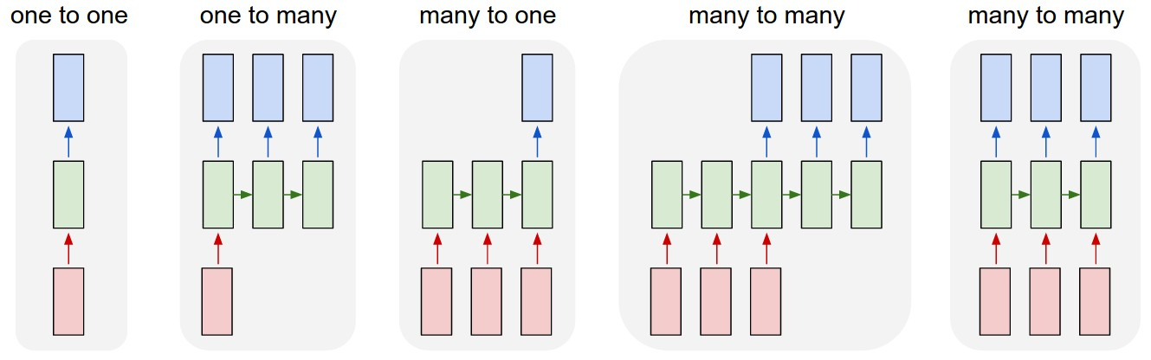
Types of Sequence Modeling Architectures
First process the input and generate a hidden representation for it
Then use it to generate an output

Slide 7
Modelling the problem
Only depends on …
Only depends on …
Problem: Each word that is output depends only on current hidden state, and not on previous outputs
Problem effect: limits the model's understanding of context

Slide 8
Transformers to the Rescue
interesting
interesting
great
boring
difficult
.
.
.
0.52
0.23
0.10
0.09
.
.
.
argmax(s)
s =
0
1
2
3
The book is very

Slide 9
Self-attention
Self-attention = Full context access
“Attention Is All You Need”
Every token attends to all previous tokens
The output representation is built from a weighted combination of all previous hidden states, not just the current one.

Slide 10
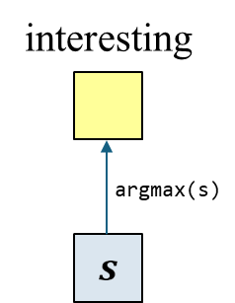
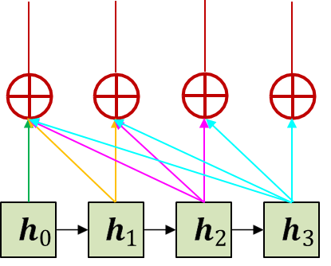
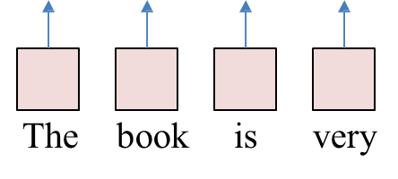
Where Does This Fit in the Bigger Picture?
Output
Decoder
What is the Encoder?
The encoder is the part of the Transformer that processes the input sequence. It reads all the input tokens (like "The book is very") and transforms them into hidden representations that capture meaning and context.
Encoder
Input

Slide 11
Where Does This Fit in the Bigger Picture?
What is the Decoder?
The decoder is used when we want to generate a full output sequence, like in translation:
"The book is difficult“ → “الكتاب صعب”
It takes the encoder’s output and step by step generates the target sequence.
Output
Decoder
Encoder
Input

Slide 12
Why Don’t We Use the Decoder Here?
Output
In this example, we are only predicting the next word ("interesting") based on a given prompt.
This is a many-to-one task, and we only need the encoder part.
So, the decoder is not needed in this type of task.
?
Decoder
Encoder
Input

Slide 13
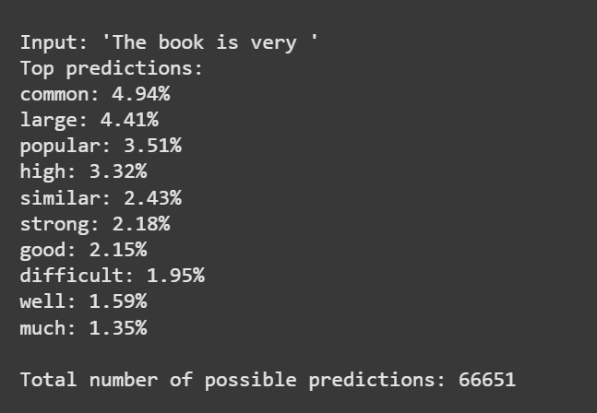
3. Activities
Exercise 1: Transformer-Based Language Model with PyTorch
In this exercise, we will build a Transformer-based language model using PyTorch to predict the next word in a sequence. We will use the WikiText-2 dataset for training and apply basic preprocessing steps. We will implement a simplified Transformer encoder from scratch to learn on the data and predict the most likely next word given a sequence of previous words.

Slide 14
4. Tasks
Task 1
In this task, you will change the sequence length (seq_len) from 5 to another value (e.g., 3 or 7), re-run the training, and then use the predict_next function to compare how the model's predictions change.
Write your thoughts…

Slide 15
5. References
[1706.03762] Attention Is All You Need
LSTM RNN in Keras: Examples of One-to-Many, Many-to-One & Many-to-Many | dl-question-bank – Weights & Biases
The Illustrated Transformer – Jay Alammar – Visualizing machine learning one concept at a time.
The Annotated Transformer
Tokenizers
NLP Preprocessing Steps in Easy Way - Analytics Vidhya
TransformerEncoder — PyTorch 2.6 documentation
Salesforce/wikitext · Datasets at Hugging Face
Welcome to PyTorch Tutorials — PyTorch Tutorials 2.6.0+cu124 documentation

Slide 16
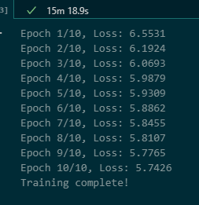
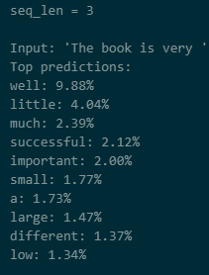
seq_len=3

Slide 17
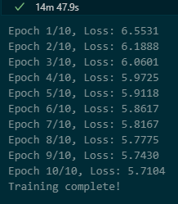
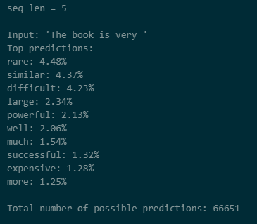
seq_len=5

Slide 18
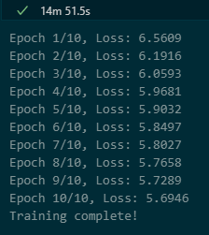
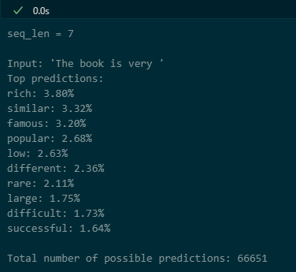
seq_len=7

Slide 19
My Thoughts
I am noticing a change in the top few words by just changing the seq_len, and for all 3 at least most of the top ten results somewhat makes sense (I can't judge perfectly as I have no knowledge of the sentences in the actual dataset). However, I did notice that with higher seq_len the model becomes less confident overall on its top guesses (top 1 for seq_len = 3,5,7 were 9.88, 4.48, 3.8 respectively).
Given that, the loss gets better as we increase the seq_len but only

